Slide 1
01 / 12
NHAI HACKATHON 7.0
EdgeLock
Enterprise-Grade Offline-First Face Authentication & 3D Liveness Detection
🧠 TEAM BINARY BRAINS
📱 React Native
🔒 Offline-First
🧬 On-Device AI

Slide 2

EdgeLock
02 / 12
THE PROBLEM
Highway field crews work in zero-connectivity zones
🏗️
✕
No internet — Remote highways have zero cellular coverage
Photo: Highway construction site
Remote NHAI field location
✕
Buddy punching — Proxy attendance with shared credentials
✕
Spoofing attacks — Photos & videos used to fake identity
✕
Audit gap — No tamper-proof digital trail of attendance
NHAI manages 1,40,000+ km of national highways across India

Slide 3
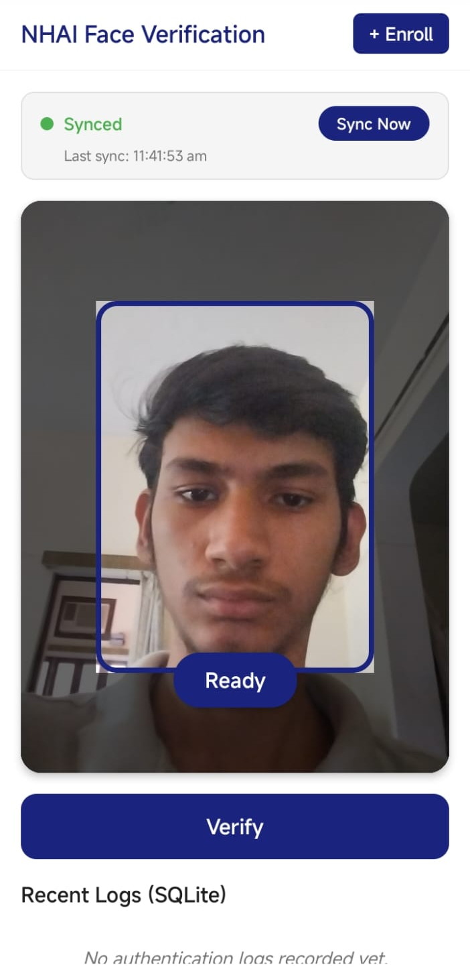
EdgeLock
03 / 12
OUR SOLUTION
100% Offline Face Auth with 3D Liveness Detection
📲
✓
On-device AI — GhostFaceNet INT8 runs entirely on the phone
✓
3D liveness — Blink + head turn + depth verification
App screenshot
✓
AES-256 encrypted — Biometric data secured at rest
Auth flow demo
✓
Auto-sync — Logs upload when connectivity returns
✓
GPS-tagged — Every auth log includes geo-coordinates

Slide 4
EdgeLock
04 / 12
ARCHITECTURE
End-to-End Pipeline
Every step runs on-device — zero cloud dependency during authentication
📷
🧠
🖼️
🔧
⚡
🎯
🔐
→
→
→
→
→
→
Camera Feed
MediaPipe Face Mesh
JPEG Decode
Face Align + CLAHE
GhostFace INT8
Cosine Match
Encrypted Log
📱 100% On-Device
⏱️ Real-Time Inference
🔒 AES-256 at Rest

Slide 5
EdgeLock
05 / 12
TECHNOLOGY
Technical Stack
Battle-tested frameworks, zero cloud dependency at runtime
⚛️
React Native + Expo
⚡
TensorFlow Lite JSI
🧠
GhostFaceNet INT8
🕸️
MediaPipe WASM
SDK 50 · TypeScript Strict
C++ bridge · Sync inference
1 MB · 512-dim embeddings
468 face landmarks
🗄️
SQLite + AES-256
🔑
Hardware Keystore
📍
Expo Location
☁️
AWS Sync Queue
Encrypted local database
iOS Keychain · Android KS
GPS-tagged auth logs
Zero-loss batch sync

Slide 6
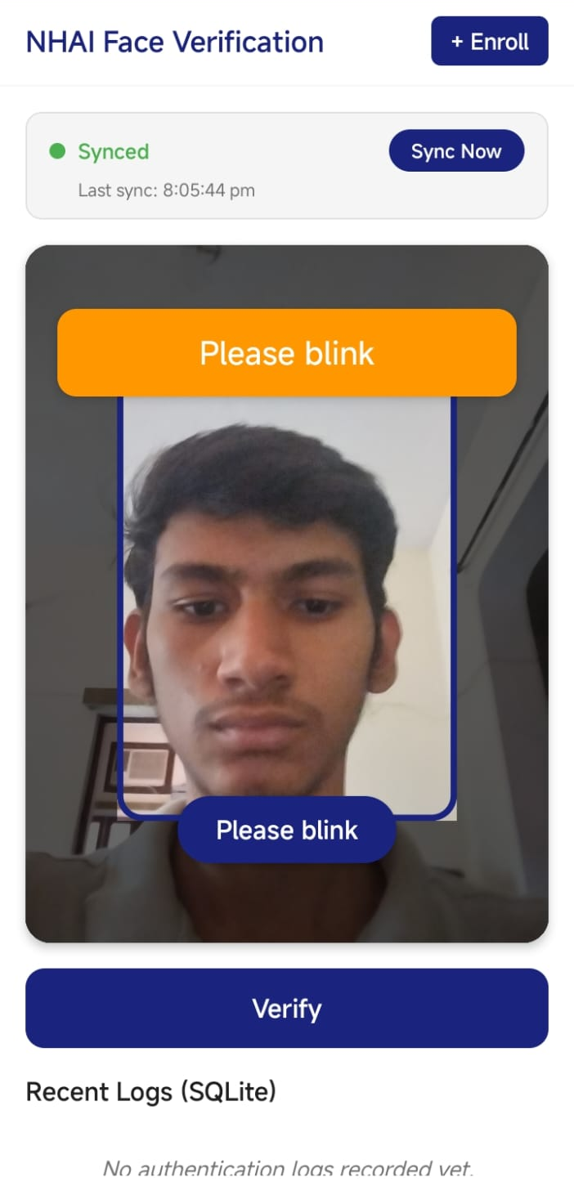
EdgeLock
06 / 12
ANTI-SPOOFING
Multi-Factor 3D Liveness Detection
Four independent checks defeat photos, videos, and masks
🤳
👁️
Eye Aspect Ratio (EAR)
Real-time blink detection — threshold < 0.33
Liveness check UI
↔️
Head Yaw Assessment
Smoothed asymmetry with hysteresis (ON: 0.12, OFF: 0.09)
"Please blink" prompt
📐
3D Depth Verification
Z-coordinate std dev separates 3D faces from flat screens
🎲
Random Challenge Order
Shuffled per session — unpredictable for attackers

Slide 7
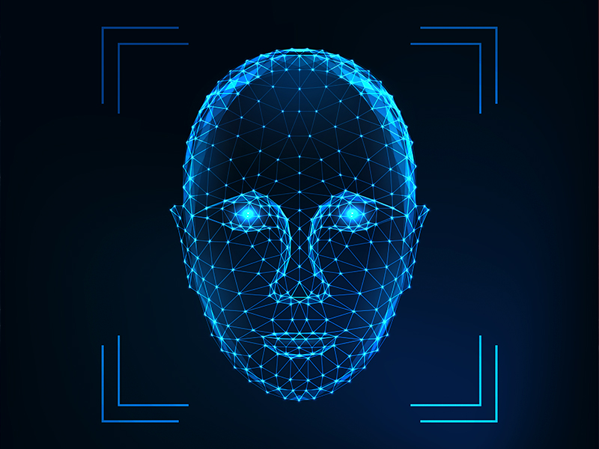
EdgeLock
07 / 12
RECOGNITION
GhostFaceNet INT8 Engine
🎯
Desktop-grade accuracy in a 1 MB on-device model
Photo: Face alignment demo
5-point warp to canonical 112×112
// Recognition Pipeline
capture → 3-shot average (180ms apart)
preprocess → 5-point face alignment (112×112)
lighting → CLAHE / histogram equalization
inference → model.runSync() via JSI
output → 512-dim L2-normalized embedding
match → cosine similarity vs encrypted DB
// Thresholds
single_user: 0.75 | multi_user: 0.84
high_confidence: 0.91 | margin: 0.05
~1 MB
512
MODEL SIZE
DIMENSIONS

Slide 8
EdgeLock
08 / 12
SECURITY
Offline-First & Zero-Loss Sync
Data integrity guaranteed — no log is ever lost
🔐
☁️
📍
Encrypted Storage
Zero-Loss Sync
Audit Trail
✓
AES-256-CBC encrypted embeddings
✓
Purge only after HTTP 200 + ID match
✓
GPS-tagged every auth event
✓
Hardware-backed Keychain/Keystore
✓
Idempotent server-side processing
✓
Photo thumbnail captured
✓
Per-install encryption keys
✓
Auto-sync on network reconnection
✓
UUID + ISO8601 timestamps

Slide 9

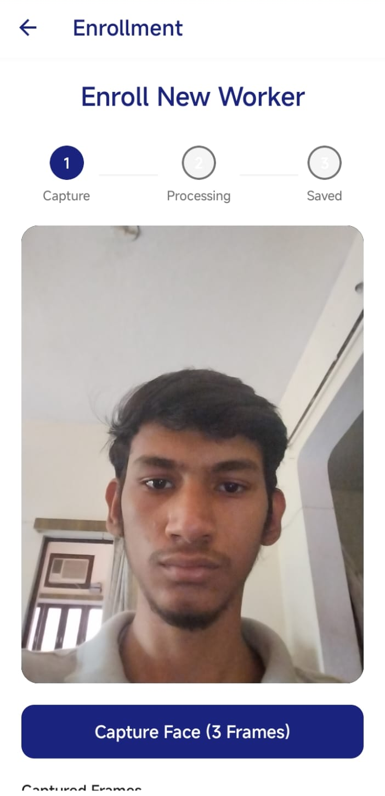
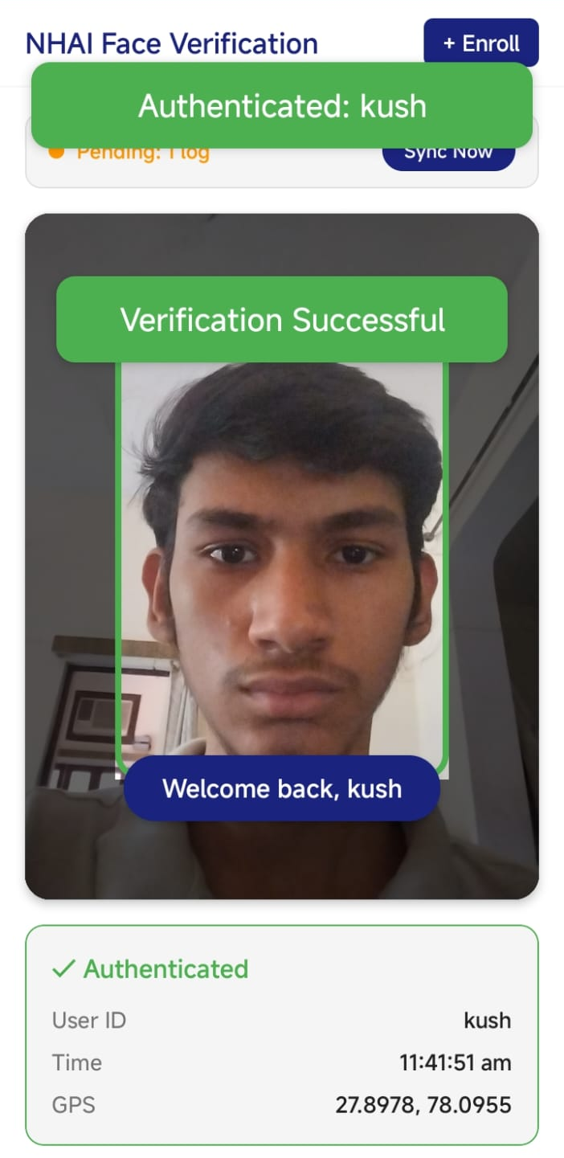
EdgeLock
09 / 12
DEMO
App Screens
Clean, minimal UI designed for outdoor field operations
🏠
👤
✅
Home screen
Enrollment
Success state
DemoAuthScreen
EnrollmentScreen
Verified result
Authentication
Face Enrollment
Auth Success

Slide 10
EdgeLock
10 / 12
METRICS
By The Numbers
~1 MB
512
468
0%
AI MODEL SIZE
EMBEDDING DIMS
FACE LANDMARKS
CLOUD DEPENDENCY
AES-256
INT8
9
0
ENCRYPTION
QUANTIZATION
TEST SUITES
DATA LOSS RISK
All inference runs on-device via JSI C++ bridge — no network roundtrip required

Slide 11
EdgeLock
11 / 12
QUALITY
Tested & Production-Ready
🛡️
Security Guarantees
✓
AES-256 encryption tested
Comprehensive test coverage across every system layer
✓
Zero-loss purge verified
✓
Idempotent sync tested
# 9 test suites covering:
database.test.ts → SQLite CRUD
liveness.test.ts → EAR, yaw, depth
preprocessing.test.ts → CLAHE, quality
recognition.test.ts → Embeddings, cosine
networkSync.test.ts → Zero-loss sync
enrollment.test.tsx → Multi-capture flow
faceAuth.test.tsx → Component render
orchestration.test.tsx → Full pipeline
e2e.test.tsx → End-to-end sim
⚙️
Build & Deploy
✓
EAS cloud builds (no Mac needed)
✓
iOS + Android from Windows
✓
TypeScript strict mode, 0 errors

Slide 12

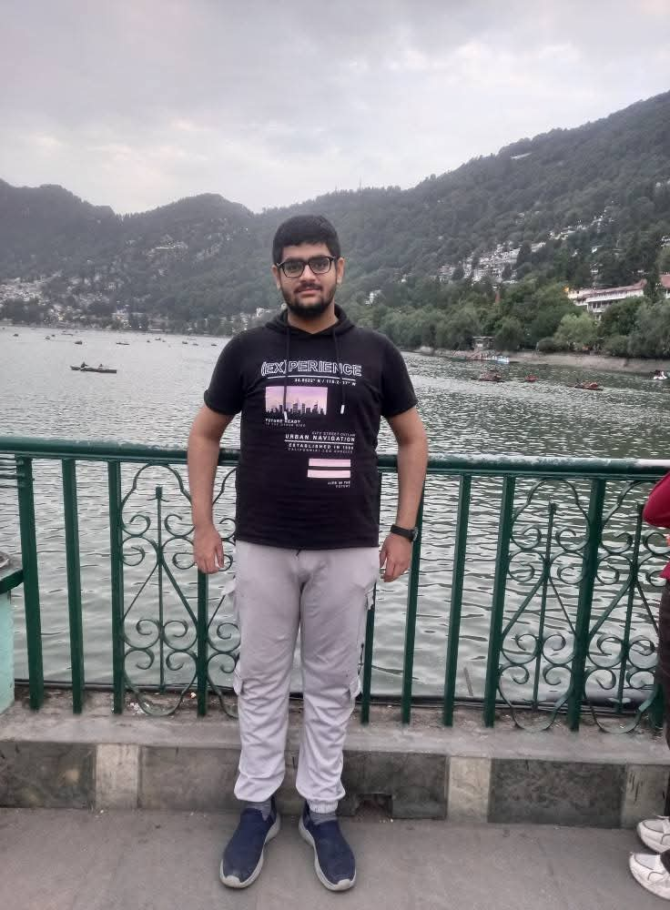
12 / 12
Thank You
EdgeLock brings enterprise-grade biometric security to India's most remote highways — fully offline.
🧠 TEAM BINARY BRAINS
https://github.com/DeveloperKush/NHAI-Hackathon-7.0
👤
Team member 2
Team member 3
KUSH SARASWAT
SMARPIT MALIK

